Slide 1
Restaurant Revenue Prediction
1
Linear Regression
2
Decision Trees and Random Forests
3
Support Vector Regression and Gradient Boosting
Simple yet effective, providing a baseline for comparison.
Capturing non-linear relationships in the data.
Advanced techniques for handling complex patterns.

Slide 2



Ensemble Modeling: Stacking for Success
Base Layer
1
Random Forest, Gradient Boosting, SVR
Stacking Layer
2
Decision Tree, Random Forest, SVM
Final Prediction
3
Optimized ensemble output

Slide 3




Hyperparameter Tuning: Optimizing Performance
Parameter Selection
Identify key hyperparameters for each model.
Search Strategy
Implement Grid Search and Randomized Search techniques.
Cross-Validation
Use k-fold cross-validation to ensure robust results.
Performance Evaluation
Assess improvement using RMSE and R-squared metrics.

Slide 4

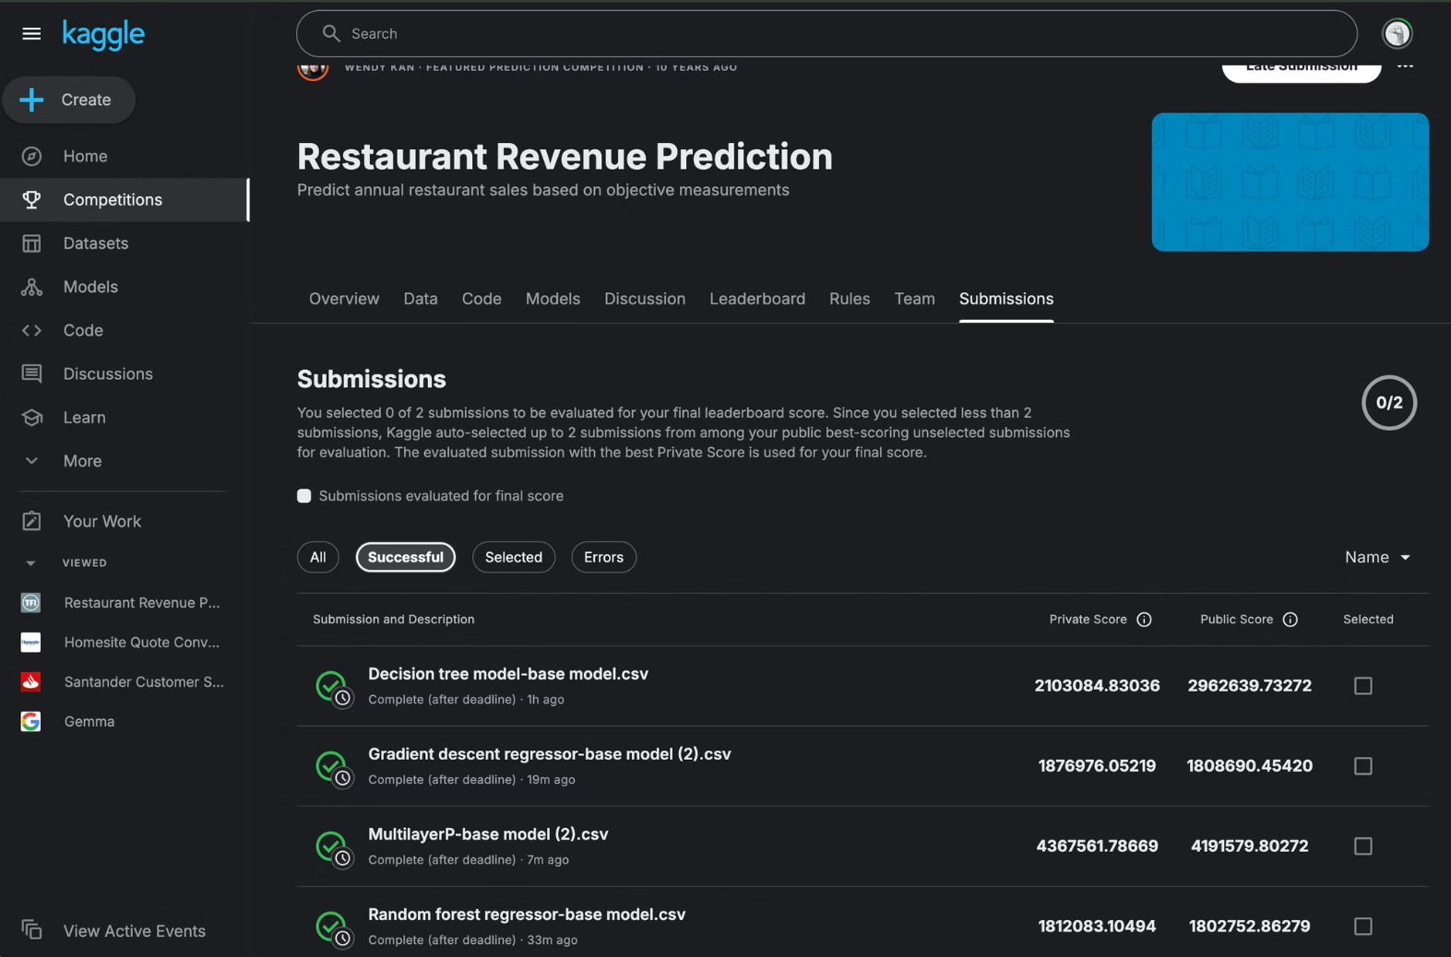
Kaggle Submissions: Measuring Success

Slide 5
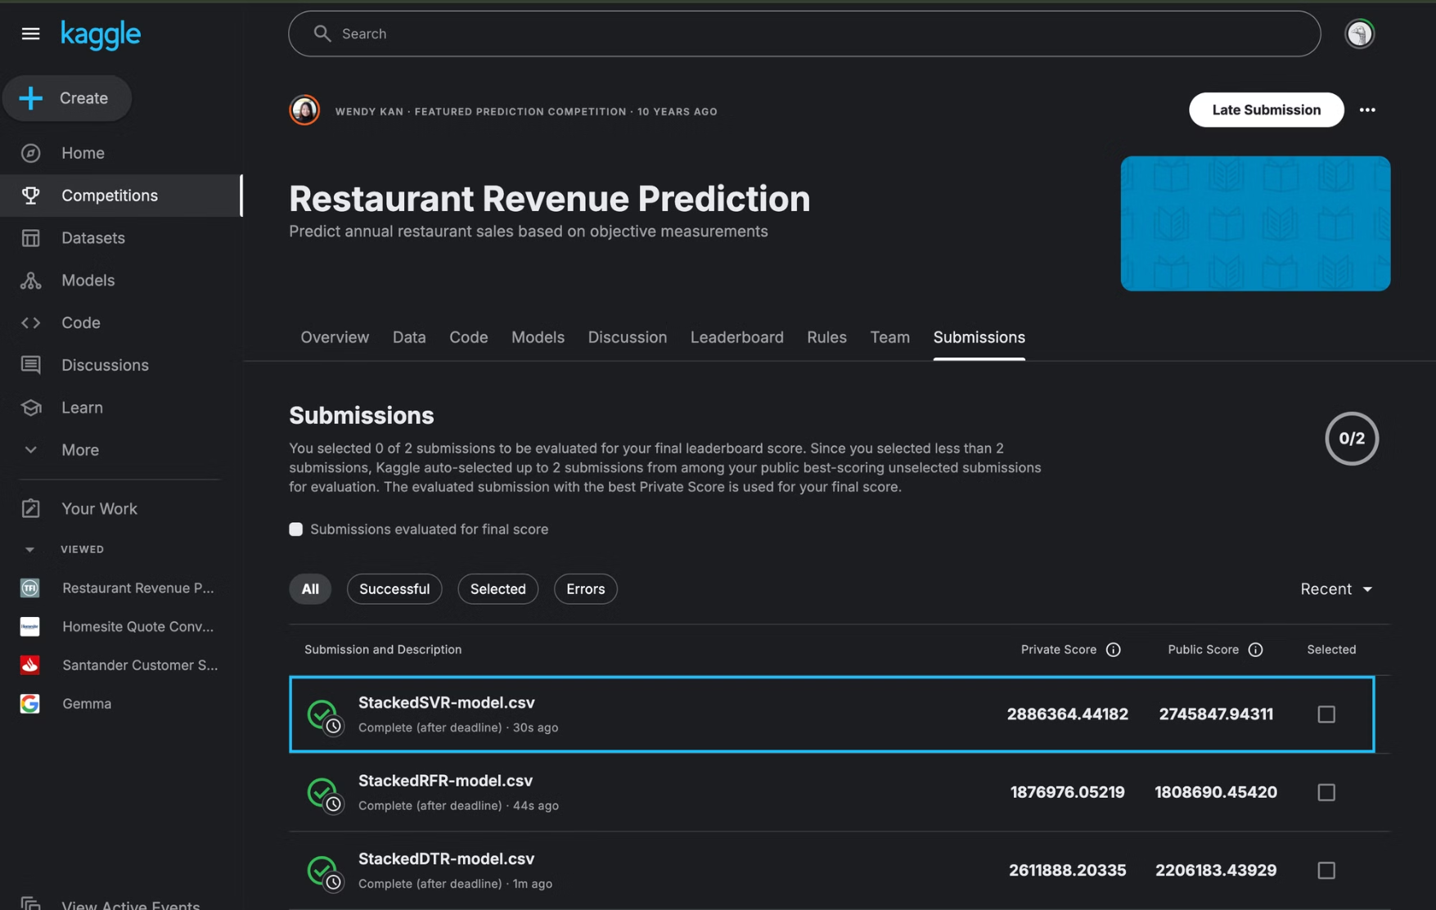

Slide 6

Key Insights: What We Learned
Ensemble Power
Tuning Matters
Stacking outperformed individual models, highlighting the importance of diverse perspectives.
Hyperparameter optimization significantly improved model performance across the board.
Feature Engineering
Creative feature combinations proved crucial for capturing complex restaurant dynamics.

Slide 7

Future Improvements: Pushing the Boundaries
1
External Data Integration
Incorporate economic indicators and local demographic data.
2
Advanced Ensembling
Explore deep learning-based stacking methods.
3
Temporal Modeling
Implement time series analysis for seasonal trends.

Slide 8



Conclusion: Recipe for Success
Insights Gained
Future Ready
Learned the critical role of ensemble methods in predictive modeling.
Prepared to tackle more complex prediction challenges in the industry.

